Slide 1
Using Data
Notes:
Jennifer

Slide 2
Why do an Annual Report?
To promote and advocate for our program
To reflect on what we accomplished
It drives our planning for the next year
It supports our growth as a team
Notes:
Susan and Travis

Slide 3
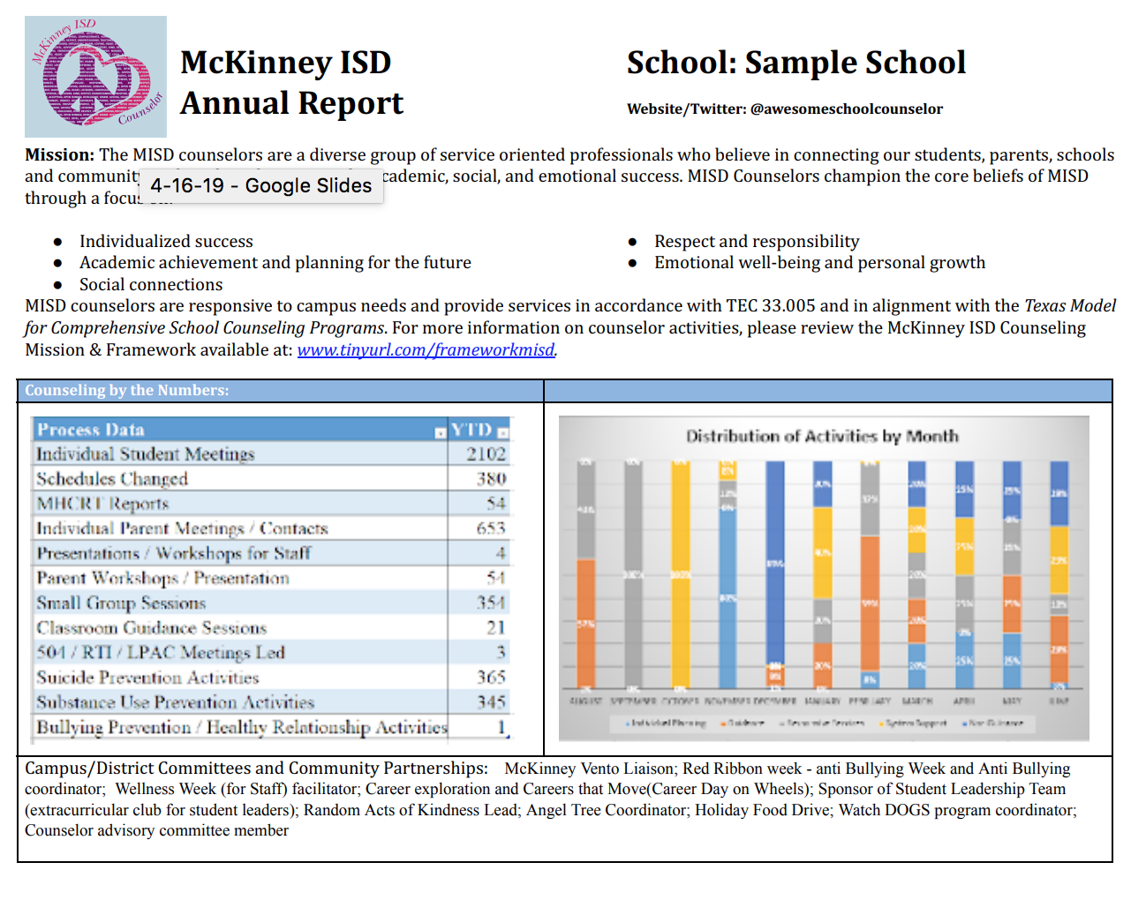
Annual Report Template (Make a COPY!)
Incorporates information directly from your CPP and your Timetracker
Focus on celebrating successes!
Reflects on your challenges and growth!
Notes:
Pam & Susan & Travis

Slide 4
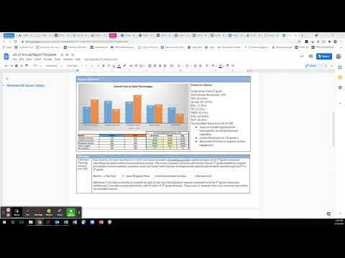
Constructing Your Annual Report
Provide the data you DO have
Include key statistics
#of MHCRT
# of guidance lessons
# of individual student meetings
# of parent meetings
# of small groups & # of sessions
Remember our framework. Make sure you explain how your addresses the Top 5 guidance topics and your CPP goals!
Secondary folks, compile your info on one report.
Notes:
Susan and Travis

